Slide 1

PARKINSONS DISEASE CLASSIFICATION USING VOCAL BIOMARKERS
INT 510 - INTERNSHIP 4
FINAL REVIEW
Vidarshana Govilesh - E0119067 B.Tech CSE (AI & ML)
Aswin G - E0119062 B.Tech CSE (AI & ML)
Supervisor
Prof. Ragavan V
Lecturer
SRIHER(DU)
SRIHER (DU)

Slide 2
INDEX
Introduction
Survey
Problem Statement
Objective
Tools and Techniques
Workflow
Methodology
Implementation
Results
Conclusion and future scope
Work done
Work log
References

Slide 3
INTRODUCTION
Parkinson's disease is a chronic and progressive neurological disorder that primarily affects movement control. It occurs when there is a loss of dopamine-producing cells in a specific region of the brain called the substantia nigra.
Dopamine is a neurotransmitter that plays a crucial role in coordinating movement and regulating various functions in the brain.
The primary motor symptoms of Parkinson's disease include tremors (involuntary shaking), rigidity (stiffness of muscles), bradykinesia (slowness of movement), and postural instability (difficulty maintaining balance).
Speech disorder (Dysphonia) is the most common motor symptom in people suffering from Parkinson’s’ disease.

Slide 4
VOCAL BIOMARKERS AND HOW ARE THEY USEFUL
Vocal biomarkers, refer to specific features or characteristics of a person's voice that can provide information about their health, psychological state, or cognitive condition.
These biomarkers are extracted from the analysis of various vocal parameters, such as pitch, tone, rhythm, intensity, and other acoustic properties of speech.
Changes in vocal patterns can be indicative of various health conditions and can reflect emotional or cognitive states.
Parkinson's disease can affect the muscles involved in speech production, resulting in a unique speech pattern known as hypokinetic dysarthria.
By analyzing these vocal biomarkers, researchers and clinicians can potentially detect and monitor the presence and progression of Parkinson's disease.

Slide 5
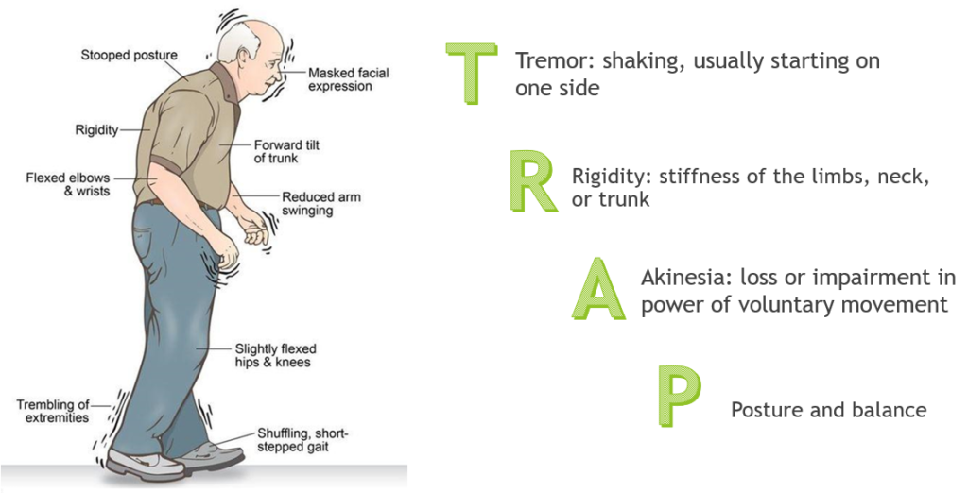

Slide 6
PROBLEM STATEMENT
The project aims at presenting a solution for Parkinson’s disease detection using Speech Data.
The main idea behind the implementation is to classify a person as Healthy or having Parkinson’s disease by analyzing the vocal biomarkers made by the person.
Given all the vocal measurement does the patient have Parkinson’s disease or not?

Slide 7
OBJECTIVE
The project’s main objective is to diagnose the disease by utilizing spontaneous speech data.
Analyzing the dataset available and understanding the common range for healthy and Parkinson’s patient.
Perform Exploratory Data Analysis and work with different oversampling techniques.
Then perform detailed analysis using the hybrid balancing technique to classify the data into Parkinson’s and non-Parkinsons by using the machine learning algorithm.

Slide 8
LITERATURE SURVEY
[1] Classification of Parkinson's Disease Using Speech Attributes with Parametric and Nonparametric Machine Learning Techniques
A speech dataset can be used to identify more precisely whether a person is suffering from Parkinson's disease or not. Voice attributes such as voice fundamental frequency, amplitude range, pitch difference, jitter, and shimmer can be used to distinguish PWD from healthy controls
First, the data is collected and the performance is evaluated by data preprocessing -, such as standardization, and normalization to improve the quality of data.
Then the data is split into train and test and fed into Parametric (Naïve Bayes, Logistic regression) and Nonparametric (KNN and Random forest) models.
Nonparametric models using Random Forest and K-Nearest Neighbors produce higher classification accuracy of 87.2% and 90.2% compared to parametric models.

Slide 9
LITERATURE SURVEY
[2] Prediction of Parkinson's Disease Using Biomedical Voice Measurements Dataset
This paper deals with selection of the data, pre processing, data transformation, data mining, interpretation/evaluation.
The XGBoost algorithm was applied using different parameter tunings to find the best estimator.
Accuracy,precision, recall were the evaluation metric used.
XGBoost algorithm achieved an overall accuracy of 95%, precision score of (1.00), and recall of (0.94).
This method has ability of the algorithm to not wrongly label negative sample as positive shows that the algorithm is 100% and as the the data is an imbalance data, it is good to use precision and recall.

Slide 10
LITERATURE SURVEY
[3] A Hybrid Approach to Parkinson Disease Classification Using Speech Signal: The Combination of SMOTE and Random Forests
This paper deals with transforming thee imbalanced dataset to balanced dataset, SMOTE method is used. Then, Random Forests classification method was used for classification of Parkinson's disease dataset.
It is seen from the obtained results that the proposed hybrid model( SMOTE and Random Forests classifier in the classification of PD dataset with the 10-fold cross-validation) has achieved good results in the discrimination of Parkinson disease dataset having a class-imbalanced problem.
To prevent this overfitting, new samples have been artificially produced by (SMOTE).The proposed hybrid method (the combination of SMOTE and random forests) achieved 94.89% classification success.

Slide 11
TOOLS AND TECHNOLOGY
Libraries such as NumPy and pandas are essential for data analysis and manipulation. NumPy provides efficient numerical computations, while pandas offers data structures and functions for data preprocessing, feature extraction, and data manipulation tasks.
Scikit-learn is a popular Python library that offers a wide range of machine learning algorithms and tools for classification tasks. It provides implementations of various algorithms like support vector machines (SVM), random forests, and gradient boosting.
Matplotlib is a cross-platform, data visualization and graphical plotting library (histograms, scatter plots, bar charts, etc) for Python and its numerical extension NumPy.

Slide 12
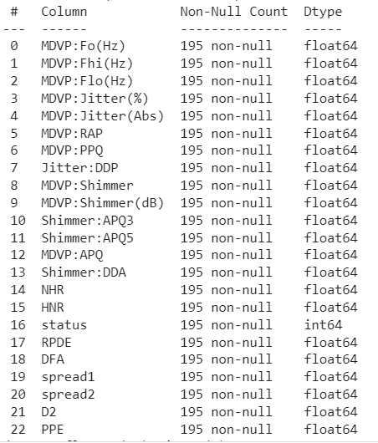
ABOUT THE DATASET
Source : UCI Machine Learning Repository Columns : 23 Columns
Rows : 195 entries
Attribute Information
name - ASCII subject name and recording number
MDVP: Fo(Hz) - Average vocal fundamental frequency
MDVP: Fhi(Hz) - Maximum vocal fundamental frequency
MDVP: Flo(Hz) - Minimum vocal fundamental frequency
MDVP:Jitter(%), MDVP:Jitter(Abs), MDVP:RAP, MDVP:PPQ, Jitter:DDP - Several measures of variation in fundamental frequency
MDVP:Shimmer, MDVP: Shimmer(dB), Shimmer:APQ3, Shimmer: APQ5,MDVP:APQ,Shimmer:DDA - Several measures of variation in amplitude
NHR, HNR - Two measures of the ratio of noise to tonal components in the voice
status - The health status of the subject (one) - Parkinson's, (zero) - healthy
RPDE, D2 - Two nonlinear dynamical complexity measures
DFA - Signal fractal scaling exponent
spread1,spread2,PPE - Three nonlinear measures of fundamental frequency variation

Slide 13
WORKFLOW
Proposed Imbalancer
Dataset
Exploratory data Analysis
Pre-processing and
train test split
Classification Model
Hyper parameter Tuning
Imbalancer Evaluation

Slide 14
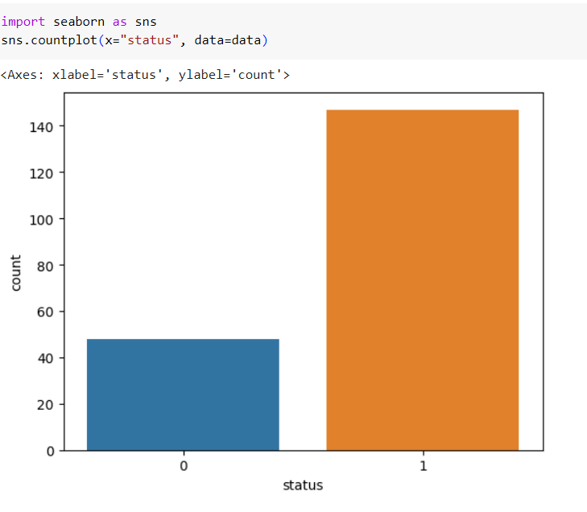
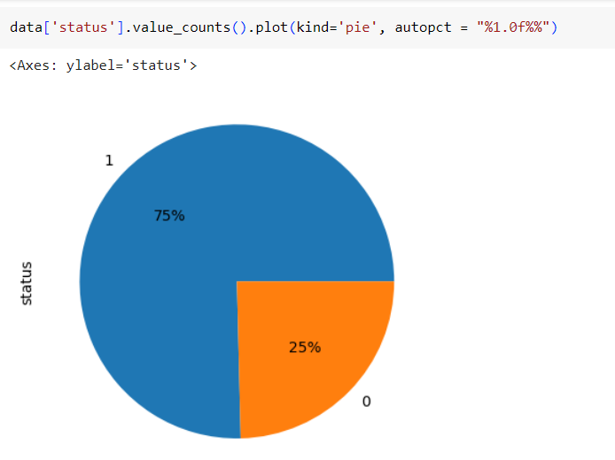
IMPLEMENTATION
Data Pre-processing:
Preprocessing refers to the transformations applied to a data set before feeding it to the model.It is done to clean raw or noisy data and make it more suited for training and analysis.
1.STANDARD SCALER
2.POWER TRANSFORMATION FOR SKEWNESS
Explanatory Data Analysis:
Exploratory Data Analysis refers to the critical process of conducting initial research on data to discover patterns, detect anomalies, and check assumptions with the help of summary statistics and graphical representations.

Slide 15
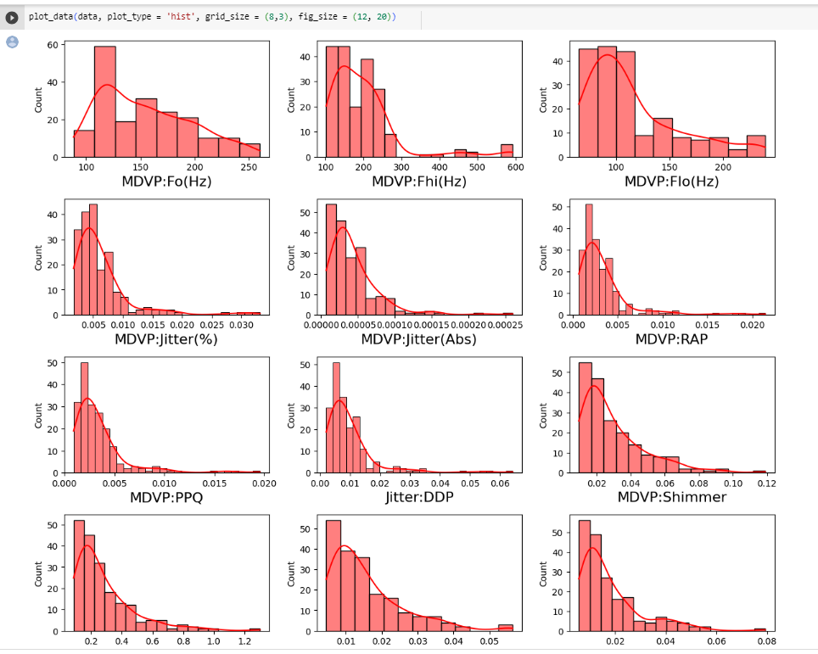
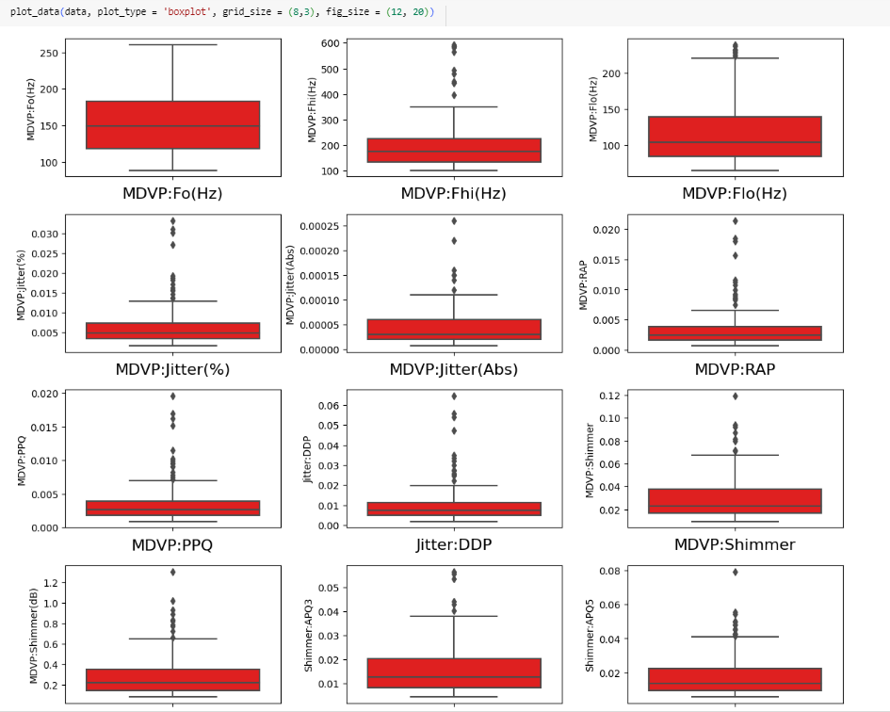
Exploratory Data Analysis

Slide 16
IMPLEMENTATION
Train-Test SPLIT :
We split the dataset into two parts—the training set and the test set. The training set consisting of 80% of the data will be used to train the classification model. The remaining 20% of the data will be reserved for the accuracy and effectiveness of the model on unseen data and will be referred to as the testing data set. Then the over-sampling techniques are used and different models are built with data generated from the over-sampling technique.
WHY OVERSAMPLING TECHNIQUE?
Imbalanced data refers to a situation in which the distribution of classes in a dataset is heavily skewed, with one class being significantly more prevalent than the others.
Biased Model Performance: the models tend to be biased towards the majority class, as they are more frequently represented in the training set.
Limited Learning: It can limit the learning capability of models when the minority class has insufficient examples to capture its inherent characteristics
Overfitting: Imbalanced datasets can increase the risk of overfitting, especially if the minority class has limited samples.

Slide 17
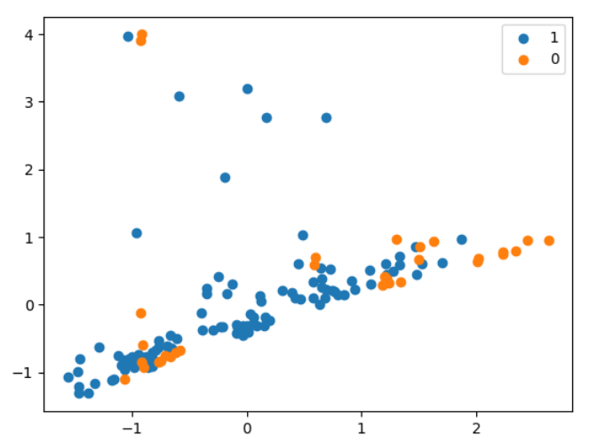
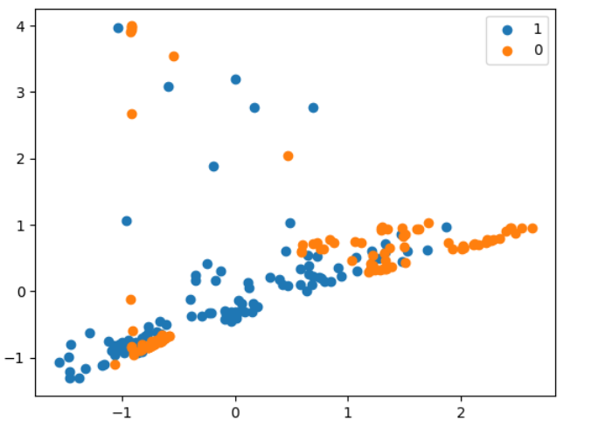
OVERSAMPLING TECHNIQUES
SMOTE (Synthetic Minority Over-sampling Technique):
Advantages:
- Helps address the class imbalance by generating synthetic samples of the minority class.
- Can increase the overall predictive performance for the minority class.
Disadvantages:
- Can introduce noisy samples if the synthetic samples are not well aligned with the actual minority class distribution.
- Does not consider the underlying data distribution and may generate samples in regions that are unrealistic.

Slide 18
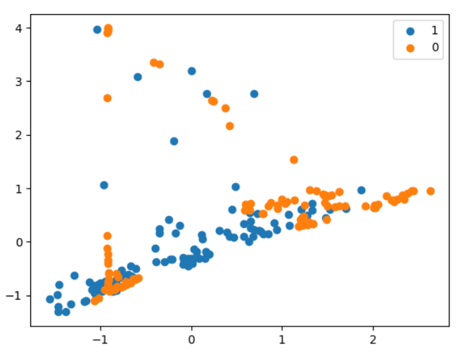
OVERSAMPLING TECHNIQUES
2. ADASYN (Adaptive Synthetic Sampling):
Advantages:
- Addresses the limitation of SMOTE by adapting the generation of synthetic samples based on the local density of minority samples.
- Places more emphasis on generating samples in regions that are harder to learn.
- Can handle datasets with multiple minority classes effectively.
Disadvantages:
- The synthetic samples generated can still be noisy, especially if the local density estimation is not accurate.
- Can be computationally expensive compared to SMOTE due to the additional density estimation step.

Slide 19
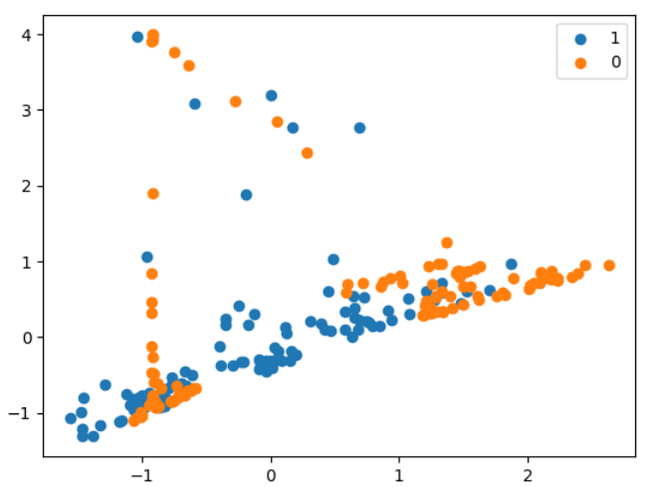
OVERSAMPLING TECHNIQUES
3. Borderline SMOTE:
Advantages:
- Focuses on the samples near the decision boundary, which are considered more difficult to classify.
- Generates synthetic samples only in the vicinity of the decision boundary, reducing the chances of creating noisy samples in the majority class region.
Disadvantages:
- May not work well if the decision boundary between classes is not well-defined or if the minority samples are scattered throughout the feature space.
- Requires careful parameter tuning to determine the appropriate distance threshold for identifying borderline samples.

Slide 20
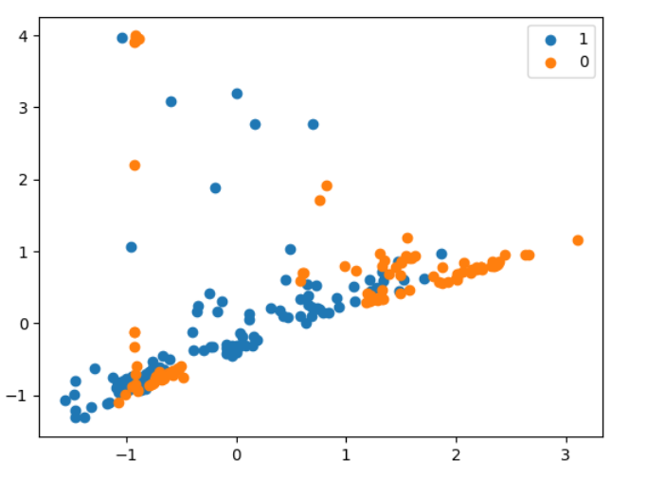
OVERSAMPLING TECHNIQUES
SVMSMOTE (Support Vector Machine Synthetic Minority Over-sampling Technique):
Advantages:
- Uses support vector machines (SVMs) to identify the potential support vectors in the minority class.
- Generates synthetic samples by interpolating between these support vectors.
- Can effectively handle datasets with complex decision boundaries.
Disadvantages:
- Can be computationally expensive due to the involvement of SVMs.
- May not work well if the minority samples are not well separated or if the decision boundary is highly non-linear.

Slide 21
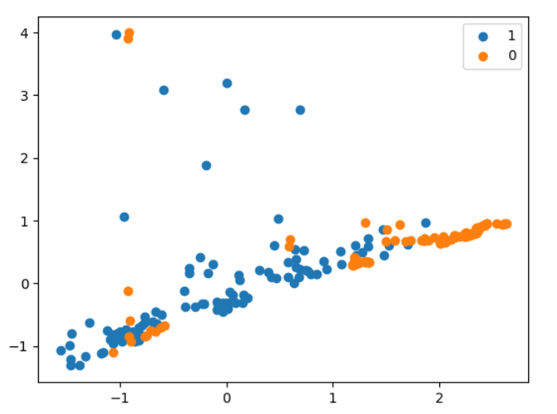
5. Kmeans SMOTE:
Advantages:
- Combines the concepts of K-means clustering and SMOTE to generate synthetic samples.
- Generates synthetic samples in regions where the minority class is densely located, avoiding oversampling in sparse regions.
- Can handle datasets with overlapping classes more effectively.
Disadvantages:
- Relies on the assumption that the K-means clustering accurately captures the underlying data distribution.
- May not work well if the clusters formed by K-means are not representative of the minority class.
OVERSAMPLING TECHNIQUES

Slide 22
IMPLEMENTATION
CLASSIFICATION MODELS
Logistic regression
Decision tree
Random forest
Support vector classifier
Naïve Bayes
KNN
Evaluation:
For assessing the performance of all these models Accuracy, Precision ,F1 score, Recall of the model are calculated. The model with the highest accuracy score is considered as the best model.

Slide 23
TEST RESULTS
 | SMOTE | ADASYN | BORDERLINESMOTE | KMEANS SMOTE | SVM SMOTE | SMOTEENN
Logistic Regression | 0.75 | 0.79 | 0.81 | 0.83 | 0.73 | 0.79
Random Forest | 0.87 | 0.91 | 0.91 | 0.87 | 0.89 | 0.79
Decision Tree | 0.81 | 0.83 | 0.85 | 0.85 | 0.75 | 0.83
SVC | 0.89 | 0.89 | 0.85 | 0.89 | 0.91 | 0.81
Naïve Bayes | 0.71 | 0.71 | 0.71 | 0.83 | 0.71 | 0.71
KNN | 0.877 | 0.91 | 0.93 | 0.89 | 0.93 | 0.85

Slide 24
HYPERPARAMETER TUNING RESULTS
METHOD | KNN | SVM
SMOTE | 0.93 | 0.87
BORDERLINE SMOTE | 0.91 | 0.93
ADASYN | 0.91 | 0.95
KMEANS SMOTE | 0.91 | 0.83
SVM SMOTE | 0.89 | 0.93
SMOTE+ENN | 0.87 | 0.87

Slide 25
PROPOSED METHODOLOGY
MAJORITY CLASS(115)
SMOTE
MINORITY CLASS(31)
IMBALANCED
DATASET
RANDOM SHUFFLER
EXTRACT SUB SAMPLE DATA
MINORITY CLASS(31)
ADASYN
NEW DATA
MAJORITY CLASS(115)
CLASSIFY AND EVALUATE

Slide 26
HYBRID TECHNIQUE TEST RESULTS
METRICS | ACCURACY
SVM | 96.5%
RANDOM FOREST | 93.5%
KNN | 94%

Slide 27
CONCLUSION AND FUTURE SCOPE
When comparing the accuracies of the different oversampling techniques with the different classification models, it was observed that throughout the different oversampling techniques SVC and KNN has performed well.
Therefore ,SVC and KNN models were taken up for hyper parameter tuning. After tuning, the results were certainly higher.
With the hybrid technique, a new dataset was sampled and the results obtained from them were higher than the previous results and Support Vector Machine was the best performing model in both the case scenario.
Therefore, we can conclude that the hybrid approach is a better suited for achieving better results for Parkinson's classification.
However, with further research to improve the specificity and sensitivity of these classification methods,we will be able to practically apply clinical settings.

Slide 28
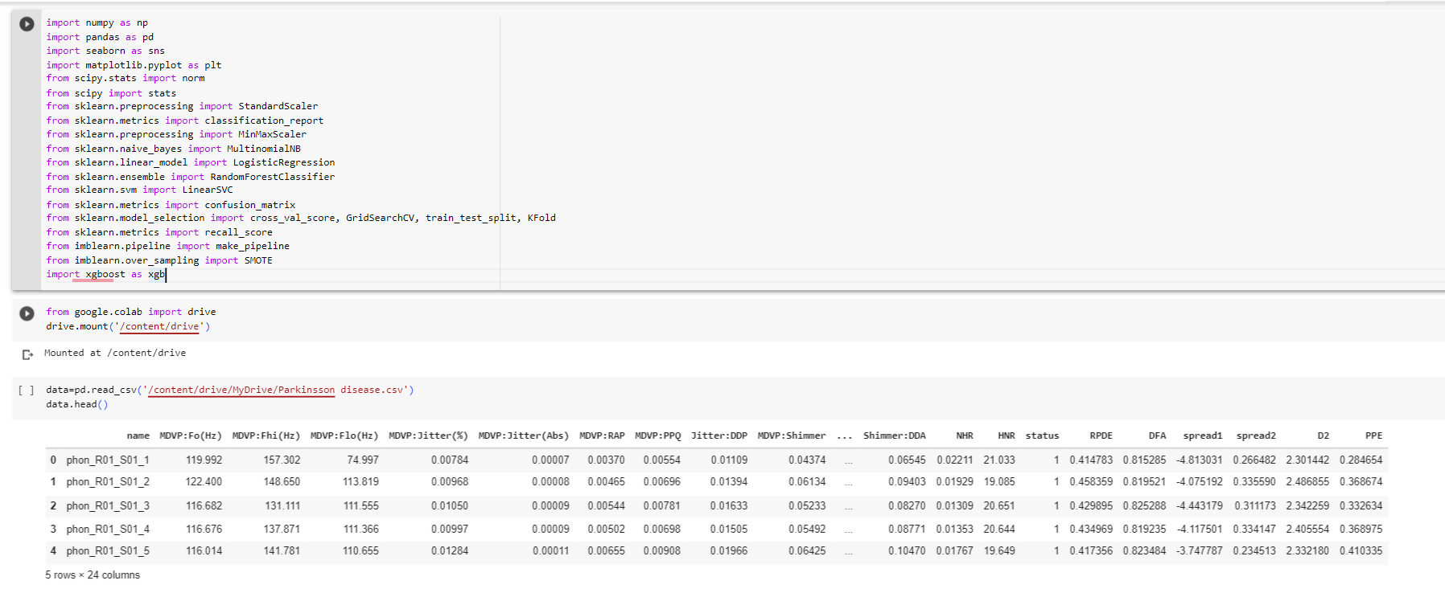
SAMPLE CODE

Slide 29
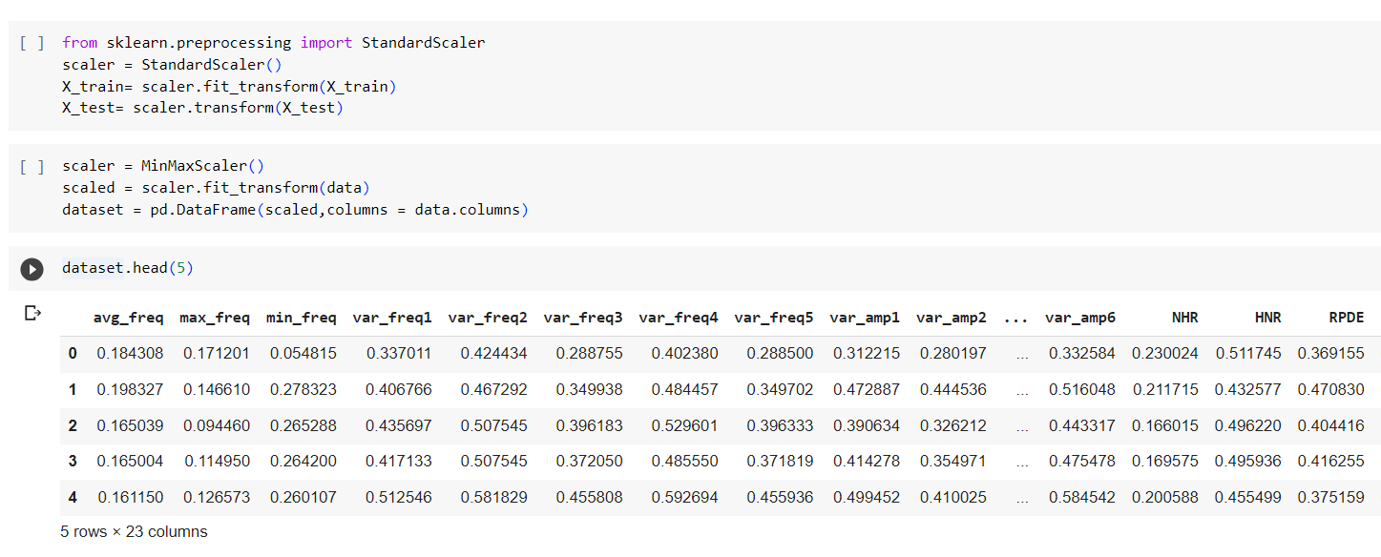
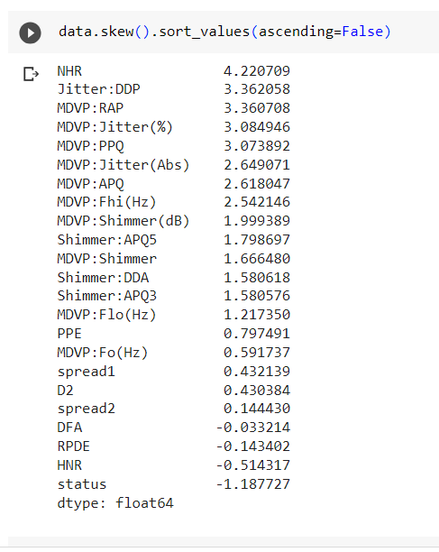
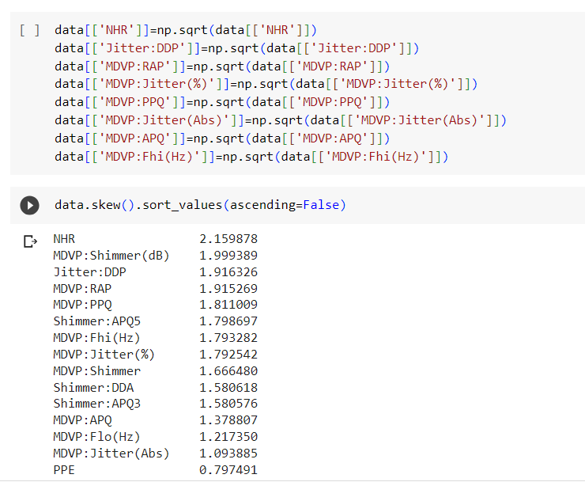

Slide 30
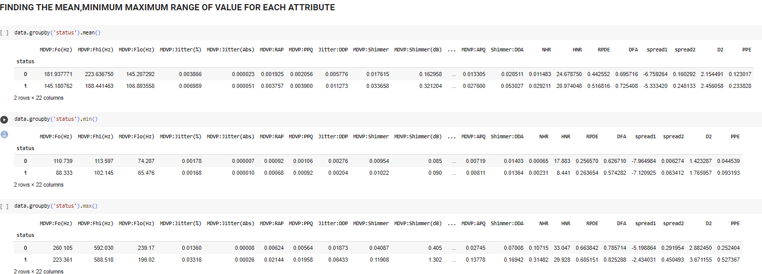

Slide 31
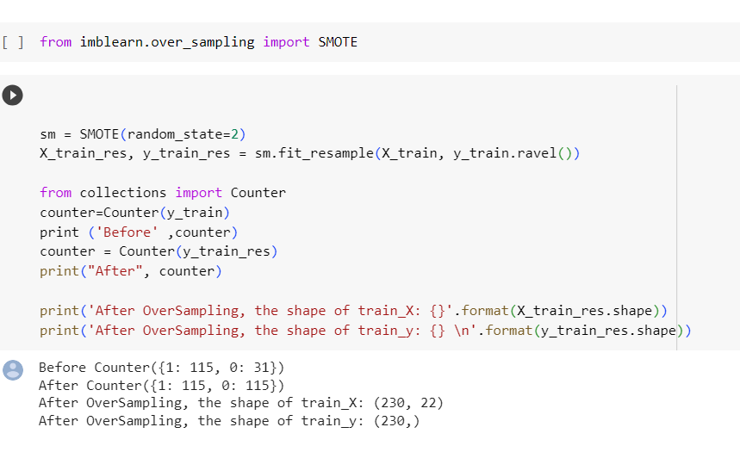
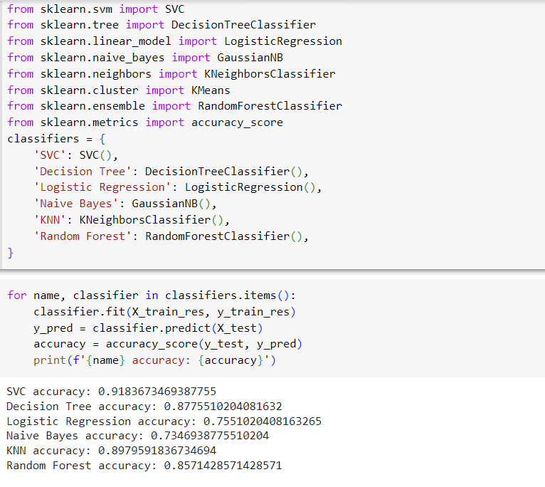

Slide 32
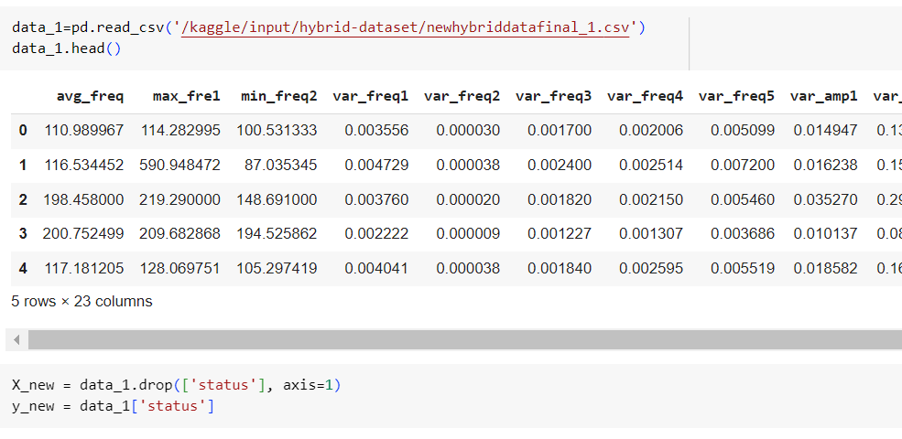
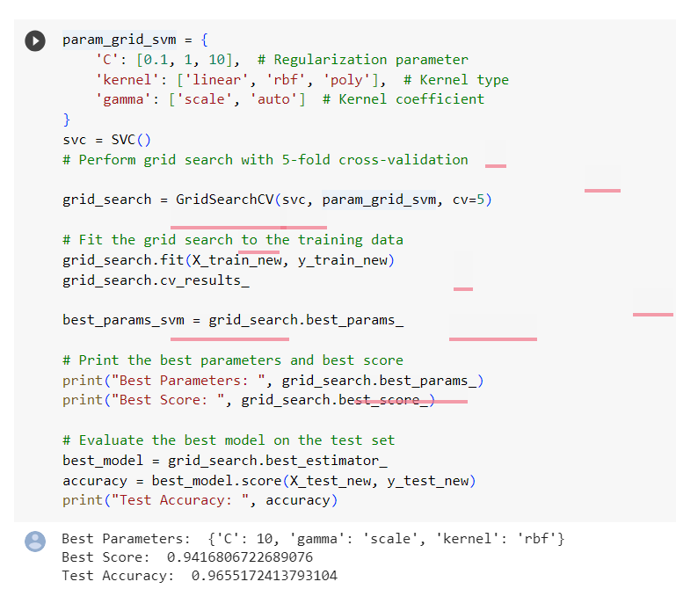

Slide 33
WORKLOG
DATE | WORK DONE
April 26- April 30 | PROJECT DISCUSSION AND TITLE FINALIZING
May 1- May 7 | SEARCHING FOR STUDY MATERIALS REFERENCES
MAY 8- MAY 12 | GOING THROUGH RESEARCH JOURNALS
MAY 13- MAY 17 | DATA COLLECTION ANDEXPLORATORY DATA ANALYSIS
MAY 18 – MAY 27 | PREPROCESSING AND OVERSAMPLING
MAY 29 – JUNE 3 | CLASSIFICATION MODELS AND BUILDING HYPERPARAMETER TUNING
JUNE 5 – JUNE 10 | NOVEL HYBRID APPROACH TECHNIQUE
JUNE 10-JUNE 20 | BUILDING MACHINE LEARNING MODEL AND CONCLUDING

Slide 34
REFERENCES
https://www.kdnuggets.com/2023/01/7-smote-variations-oversampling.html
https://imbalanced-learn.org/stable/over_sampling.html#smote-variants
https://www.ninds.nih.gov/health-information/disorders/parkinsons-disease
https://www.analyticsvidhya.com/blog/2021/03/comparison-of-pearson-and-spearman-correlation-coefficients/#:~:text=Pearson%20and%20Spearman%20correlation%20coefficients,coefficient%20evaluates%20the%20monotonic%20relationship
https://scikit-learn.org/stable/modules/generated/sklearn.neighbors.KNeighborsClassifier.html

